Slide 1
Traveling Waves and Stratified Diffusion
Modeling Stratified Diffusion in Biological Invasions by Shigesada et al. (1995)

Slide 2

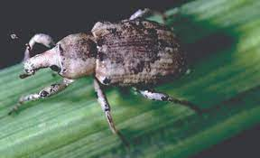
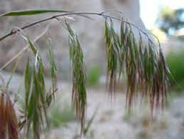
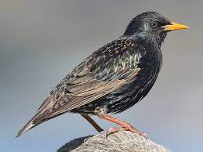
Content
Recap Last Time
Questions
Traveling Waves
Stratified Diffusion
North American Muskrat
Rice Water Weevil
Cheat Grass
European Starling

Slide 3
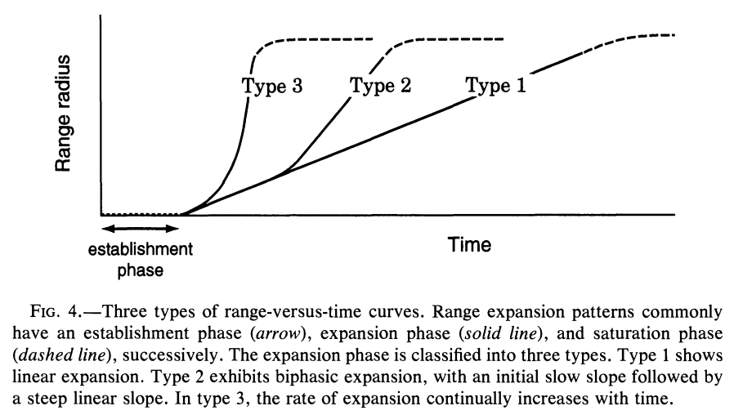

Previously on Aidan Explains Invasive Species Population Dynamics:
1) We sought to understand the conditions that yield an establishment phase.
2) We analyzed the long-term behavior of populations undergoing Neighborhood Diffusion (using the Short Distance Dispersal Model).
Notes:
Recall, neighborhood diffusion causes type 1 expansion. If you’re thinking “wait, what about the other two?”, then buckle up and get ready for this magnificent presentation.

Slide 4
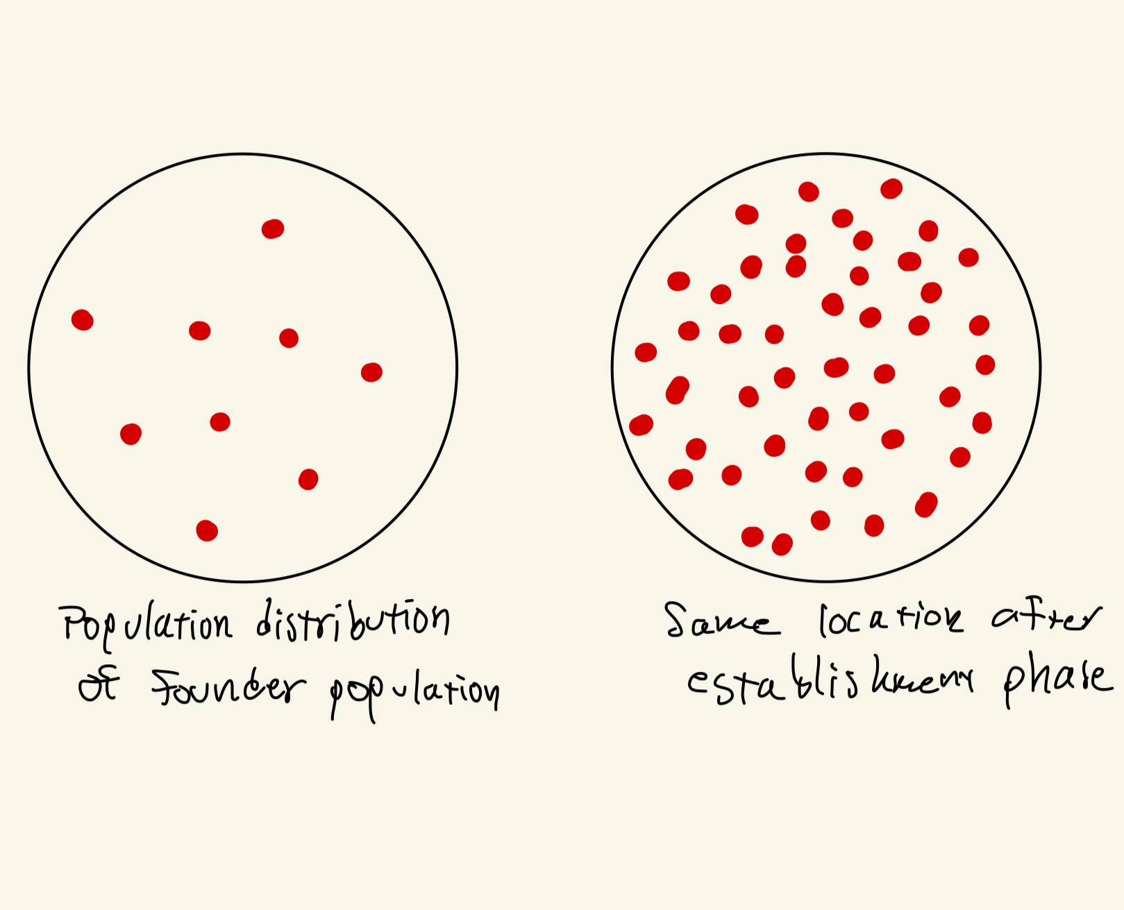
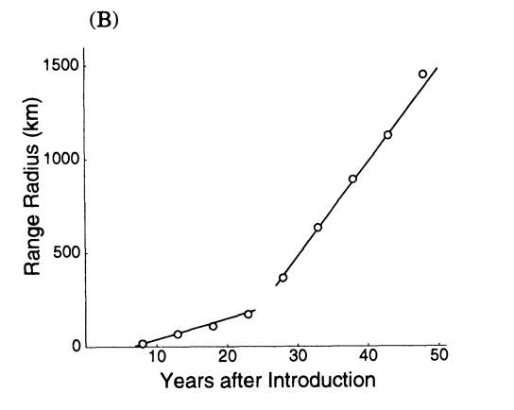
RECAP: Phases of Invasions
Establishment Phase
The period between the founding of a population and the detection of such population.
Range Expansion
The spread of a population into previously unoccupied regions. In invasions, the spread often accelerates due to various factors.
Notes:
ALSO, if you’re wondering why there’s this abrupt change in linear regression, then you’re at the right presentation. I’ll address that hopefully at the end.

Slide 5
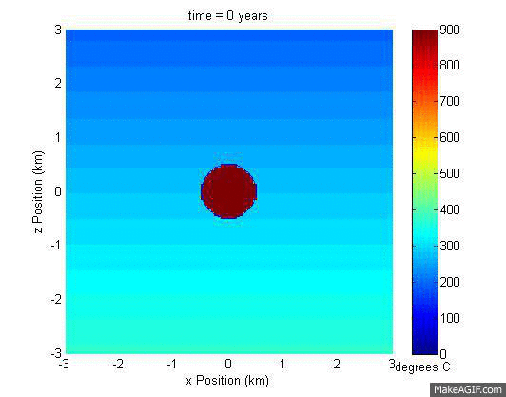
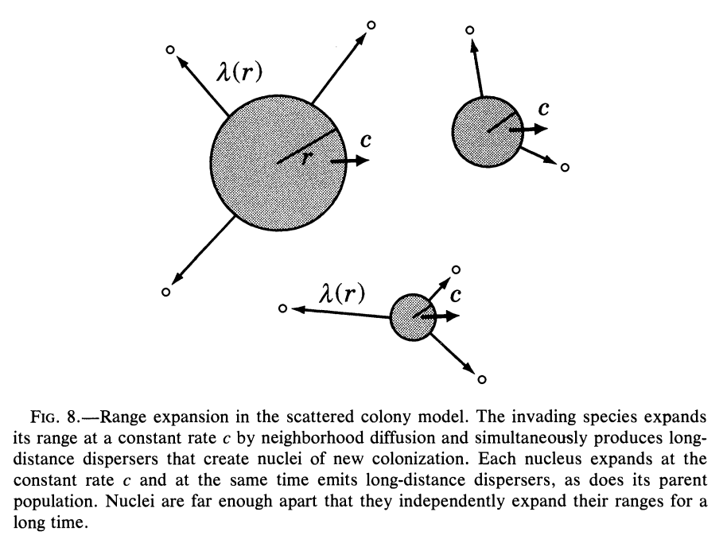
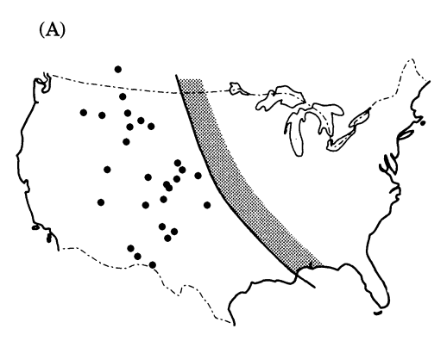
RECAP: Means of Range Expansion
Neighborhood Diffusion
Members of a population spreading out locally
Long Distance Migration
Members of a population moving large distances to establish new colonies
Stratified Diffusion
A population expands with a combination of ND and LDM

Slide 6
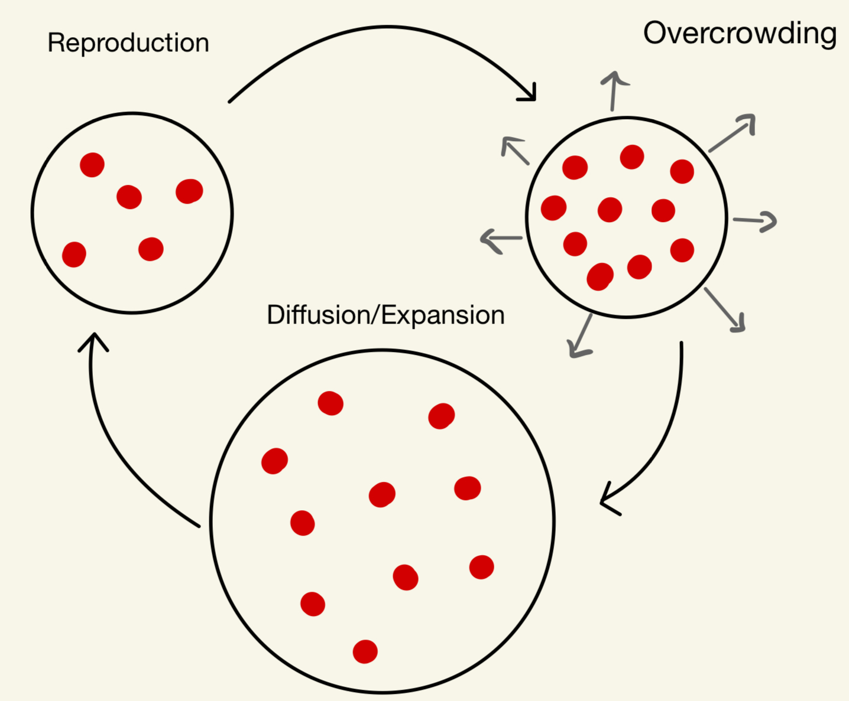
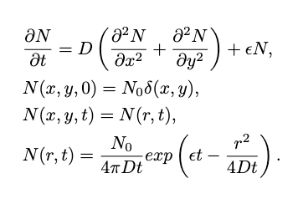
RECAP: Short Distance Dispersal
Notes:
In a way, this is a simple model that introduced us to the role that the diffusion reaction equation plays. This model assumes that a population’s range expansion is dominated by neighborhood diffusion which is common in slow, grounded animals like the North American Muskrat. When we get to the notion of detectability, we can see how an establishment period can occur.

Slide 7
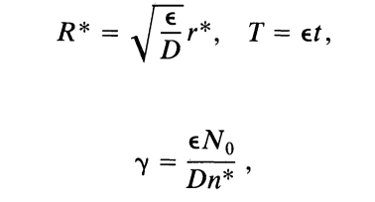
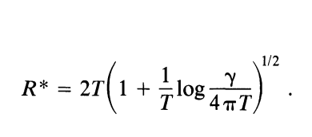

Minimum Detection Density
After Nondimensionalizing,
We found an equation that locates our population frontier at any given time.
Then, we set R* = 0 and solved for a relationship between and Te.

Slide 8
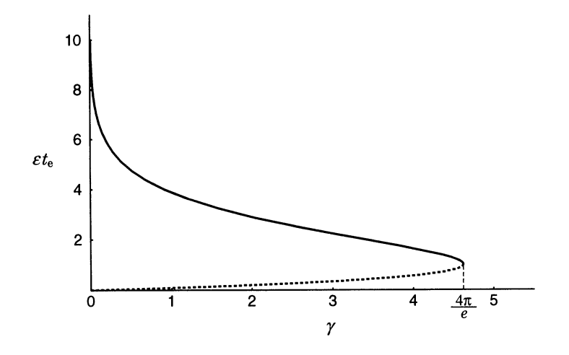
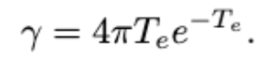
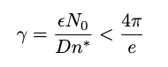
RECAP: Establishment Phase Condition
Establishment Phase Bifurcation Diagram
We concluded that gamma is related to the establishment phase by the following equation:
An establishment phase exists when:

Slide 9
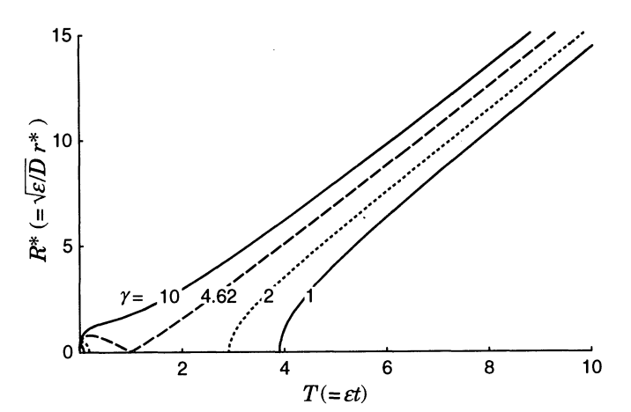
RECAP: Establishment Period
We observed a linear relationship in the long term. This linearity is more relevant than I emphasized last time…
*Traveling waves
Notes:
So, if epsilon is sufficiently smaller than D, then we will see an establishment period whose length can be calculated.

Slide 10
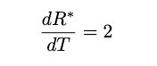
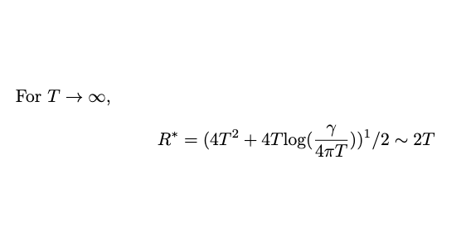
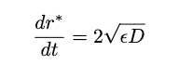
Long Term Behavior
Linearity of R* vs T Graph
What is the speed?
Take the limit of R*
dR*/dT = 2
Redimensionalize
dr*/dt = 2√εD

Slide 11
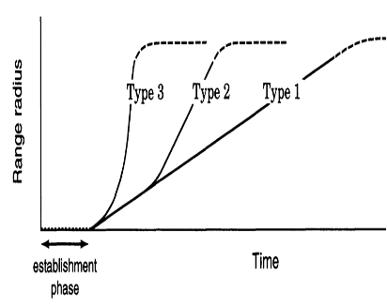
RECAP: Long Distance Migration and Stratified Diffusion
Long Distance Migration (LDM): Members of a population that move large distances to establish new colonies. Combining LDM with Neighborhood Diffusion is Stratified Diffusion.
Notes:
Long distance Migration is the main distinction that separates type 2 and 3 expansion patterns from the type 1 pattern we just explored.

Slide 12
Questions
What is a traveling wave and why do we care about them?
How do we incorporate long distance migration?
Notes:
I’ll give you a hint, traveling waves are important, not only in the incorporation of long-distance migration with neighborhood diffusion, but also simply in neighborhood diffusion.

Slide 13
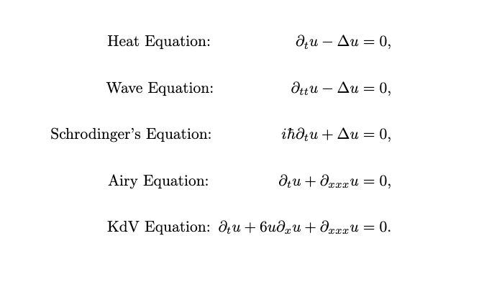
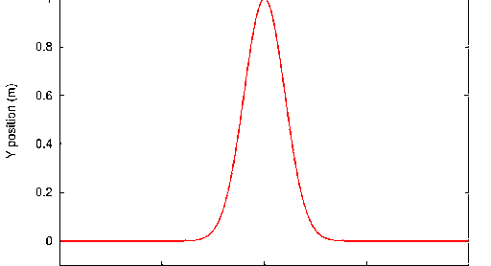
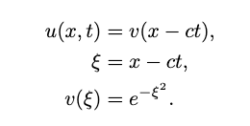
Traveling Waves
Often used to solve more complicated PDEs
Offer intuitive insights about the evolution of an independent variable

Slide 14
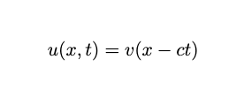
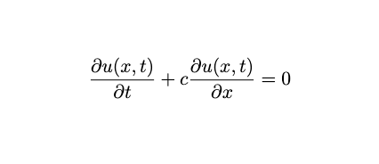
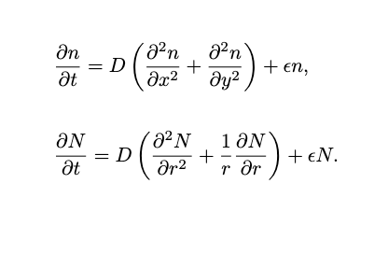
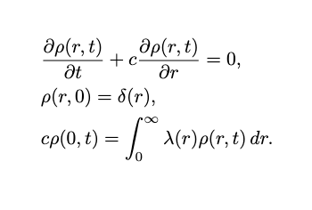
Traveling Waves in Population Dynamics
They are very simple!
Key word: Ansatz
Original Equation
Stratified Diffusion Model Sneak Peak!
Notes:
Long distance Migration is the main distinction that separates type 2 and 3 expansion patterns from the type 1 pattern we just explored.

Slide 15
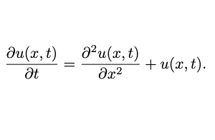
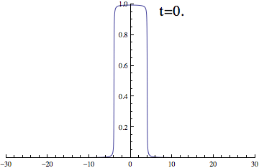
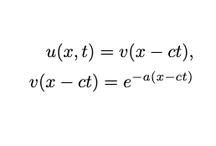
Digression: 1D Reaction Diffusion (KPP) Equation
Objective: Make an ansatz (good guess) on the form of a traveling wave that would solve the 1D KPP Equation. Then, see what implications arise about the speed of our wave. This is an exercise to introduce traveling wave solutions to PDEs.
Notes:
Basically, I’m going to show you how applied mathematicians approach complicated PDEs with traveling waves. There is a certain kind of analysis that takes place. We want to simplify everything that we can to provide the easiest, most broad insights.
Spoiler alert, this decaying exponential is our ansatz because this is a good estimate of the behavior of a reaction diffusion equation in one direction.
It’s important to note that a is a positive constant

Slide 16
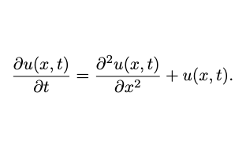
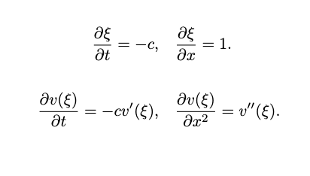
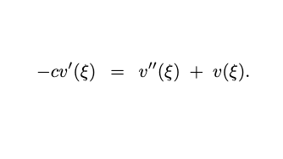
Replace u(x, t) with v(ξ)
Using some calculus, we can substitute our wave solution v(ξ) into the original PDE to get a second order ODE.
1
2
3
Original Partial Differential Equation
Substitute Derivatives using Chain Rule
New Ordinary Differential Equation!

Slide 17
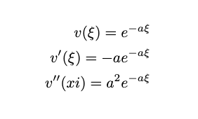
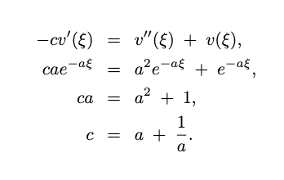
Apply the Ansatz
Notes:
YAY! c depends on a, a positive constant, and will always be positive for all a.
This is fairly anti climactic, but it’s nice to know that this works.

Slide 18
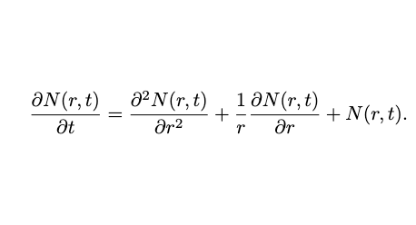
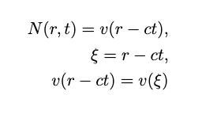
What about the Radial KPP?
We expect a similar ansatz to apply in this system because of the results from last time where our population forefront was advancing at a constant positive speed.
Let’s repeat the process

Slide 19
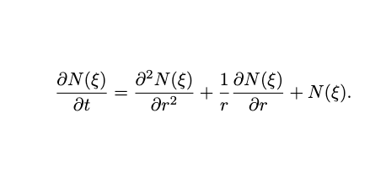
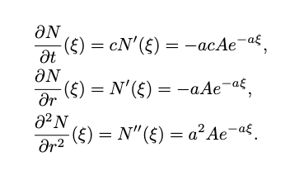
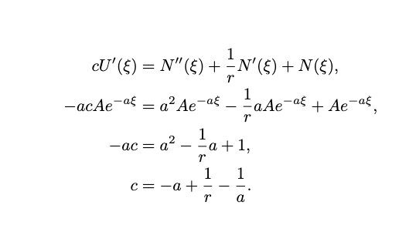
Replace N(r, t) with v(ξ)
Repeating the previous steps identically gets us here.
1
2
3
Original Partial Differential Equation
Substitute Derivatives using Chain Rule
New Ordinary Differential Equation!
Notes:
Look, c is negative AND it depends on r. What??? That’s not good. This is how we know that a very reasonable guess, v(xi) = exp(-a(xi)) doesn’t work analytically with the radial KPP.

Slide 20
Traveling Wave Takeaways
The radial KPP cannot be solved using a standard traveling wave with a constant speed.
This is why I did all those gymnastics last time to arrive at the long-term expansion rate. Even though there was linearity, it was hidden.

Slide 21
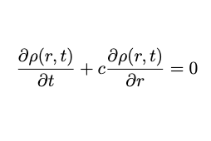
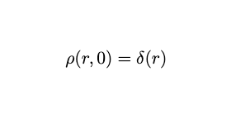
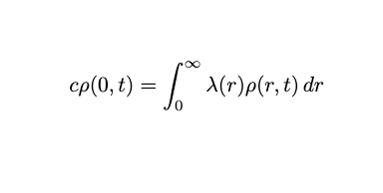
Stratified Diffusion – Scattered Colony Model
To create a traveling wave model that models stratified diffusion, we need to take from mathematical biologists Anderson Gray McKendrick and Heinz Von Foerster.
The McKendrick-Von Foerster Equation (MFE)
Notes:
The MFE is very delicate. Without the boundary condition, we fall into a standard traveling wave equation which we just proved does not successfully model the 2D radial diffusion reaction system.
Rho is a density distribution again. But, to gain insight on a population’s range we have to go one step further since we’re going to be dealing with multiple colonies at a time.

Slide 22
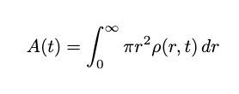
Measuring Range with an Area Function A(t)
Take the solution to the MFE and compute A(t) as such →

Slide 23

Assumptions and Function
Only parent colony emits offspring
Very far long distant migrants
Overlapping does not occur

Slide 24
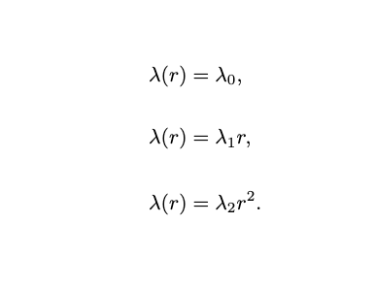
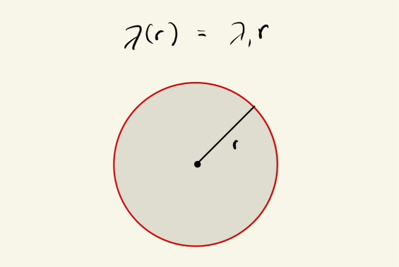
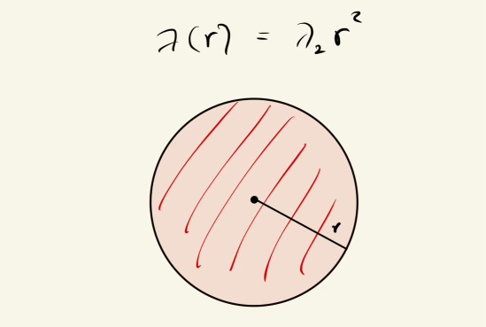
Offspring Colonies and λ(r)
Recall the Boundary Condition from the MFE →
What is λ(r)?

Slide 25

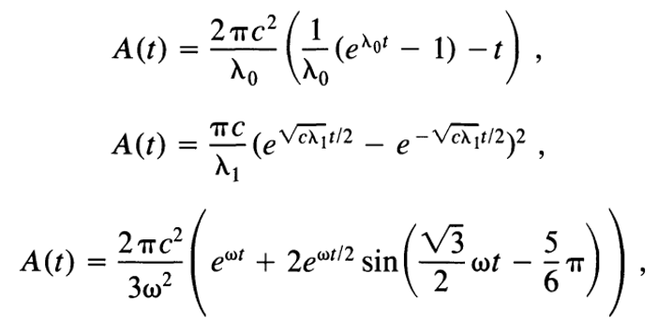
Solutions with Different λ(r)
Through a tedious process, we can find three expressions for A(t), each associated with an expressions for lambda.
Now, we can graph these.

Slide 26
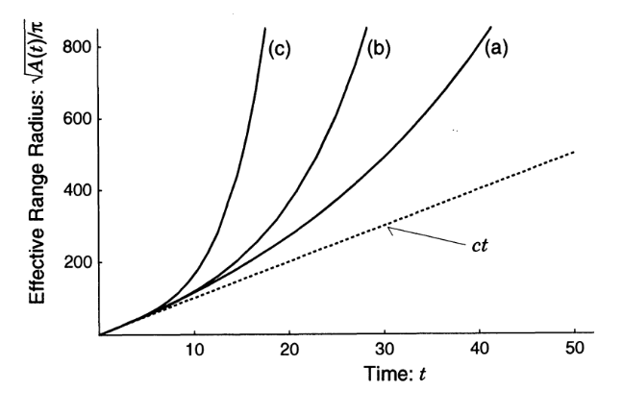
Scattered Colony Model Area Functions
Range Vs. Time
Notes:
A big problem is the long-term behavior. Everything turns into an exponential, type 3 behavior. This should not be happening, and it’s because of the assumption that colonies don’t coalesce. In the long-term, the offspring colonies end up colliding, overlapping, and causing an overcalculation of the total range. How do we address this issue?
The coalescing colony model
Also, notice there’s this ct dotted line. Remember when I said there was a traveling wave hidden within the short distance dispersal model? Well, this is what happens when the boundary condition is 0. Then, we have a standard traveling wave, which we know analytically and now graphically to be linear!

Slide 27

Coalescing Colony Model
Notes:
Previously, the scattered colony model would overcount this overlapping area after offspring colonies meet with the parent colony.
This model seeks to edit the Von Foerster model to account for this overlapping. The problem is that the MFE is so delicate already, and this math doesn’t really exist. Shigesada tries to force it, but it doesn’t hold water.

Slide 28



Assumptions and Function
Only parent colony emits offspring
Frequent and short long distant migrants
Overlapping occurs

Slide 29


Changes
Traveling Wave Solution
&
New Area Function

Slide 30

Coalescing Colony Model Final Figure
Notes:
Previously, the scattered colony model would overcount this overlapping area after offspring colonies meet with the parent colony.
This model seeks to edit the Von Foerster model to account for this overlapping. The problem is that the MFE is so delicate already, and this math doesn’t really exist. Shigesada tries to force it, but it doesn’t hold water.

Slide 31
Conclusions
Scattered Colony Model
Stratified Diffusion is hard to model. Shigesada used the MFE to incorporate long distance migrants, but there were a lot of assumptions required.
Coalescing Colony Model

